Slide 1

BITRATE
I
A Machine Learning Game
BITRATE I N C .

Slide 2


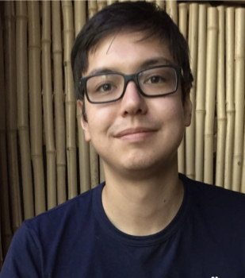

T.
EA.
M.
#01 BITRATE
Abraham Eapen
Ricky Kharawala
Michael Cavellero
Jeff Coen
Backend Developer
Front-End Developer
Backend Developer
Front-End Developer

Slide 3


#02 BITRATE
Machine
Learning
Fireball
Phase I
Front-End D3
Phase II
Python Script
Phase III
Machine Learning Algorithm

Slide 4

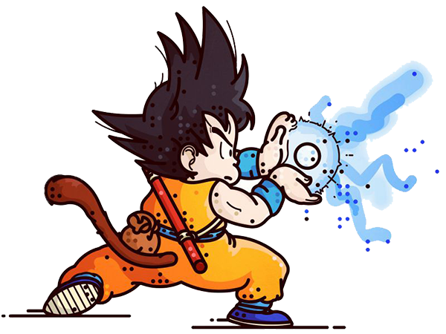


Machine Learning Fireball
#03 BITRATE
Notes:
We set out to build a machine learning game visualized with D3.
We first need a JSON dataset for our D3 code to read and modify.
Then we need a target and then a character
A fireball to hit the target with.
ANDDDD Since 1 fireball isn’t enough data for the machine learning algo to learn we need more fireballs!

Slide 5

Back-End Process
#04 BITRATE
{Velocity}
{Distance}
{Success/Failure}
Notes:
Now to take a look at what's happening behind the scenes
Our modified JSON data from our front-end consists of Velocity(randomized), Distance(user input), and success/failures.
Its then fed into our machine learning script to pump out new precise dataset to hit the target which is then given back to the front-end.

Slide 6
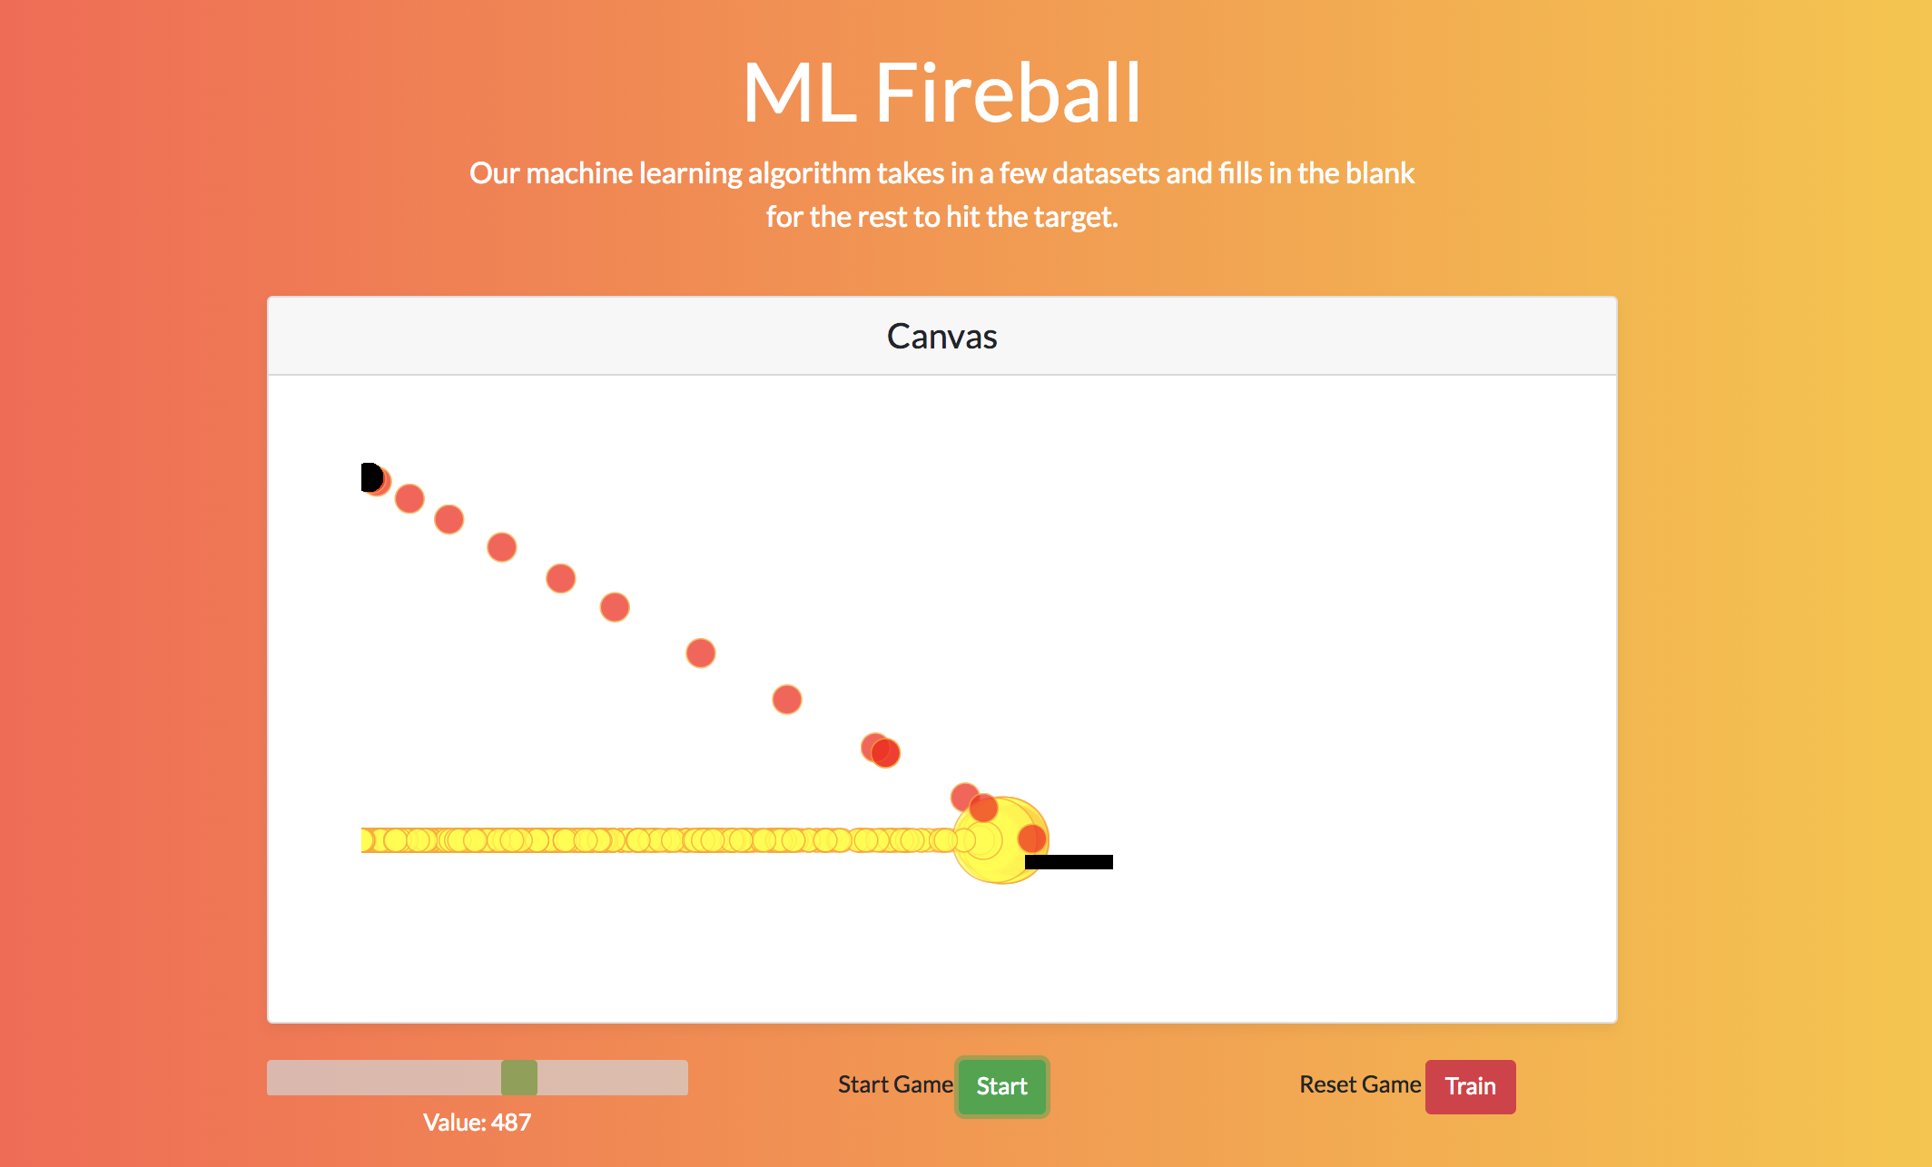
#05 BITRATE
Phase I – Front-End & D3

Slide 7
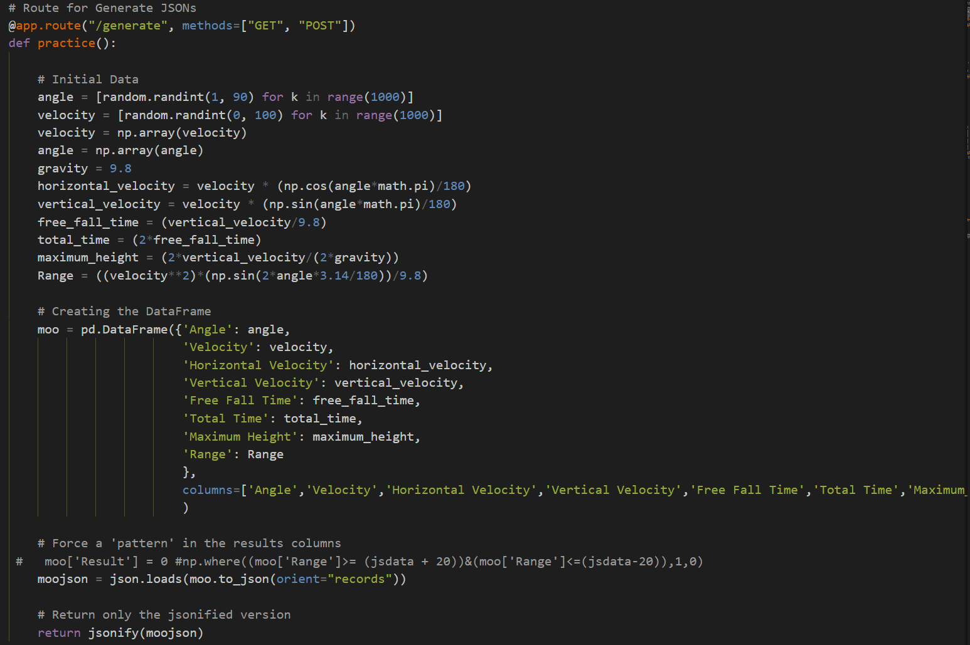
#06 BITRATE
Phase II – Python Script

Slide 8
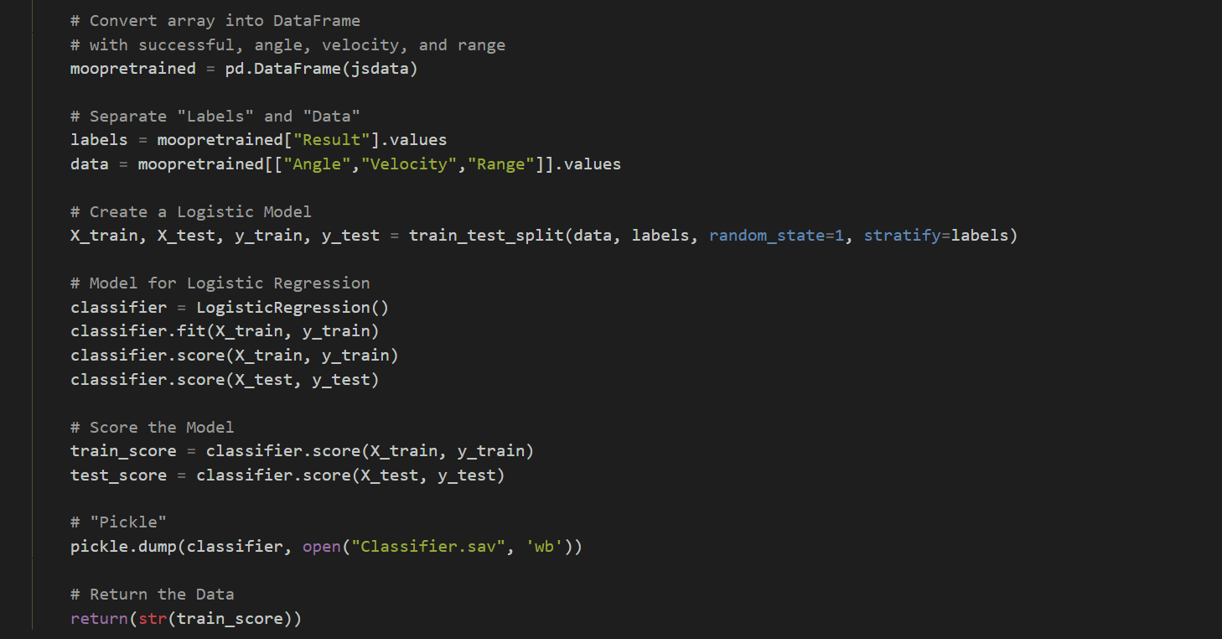
#07 BITRATE
Phase III – Machine Learning

Slide 9
Formulas
#08 BITRATE
// Range = ((velocity**2)*(np.sin(2*angle*3.14/180))/9.8)
// Angle = [random.randint(1, 90) for k in range(1000)]
// Velocity = [random.randint(0, 100) for k in range(1000)]
// Gravity = 9.8
// Horizontal_velocity = velocity * (np.cos(angle*math.pi)/180)
// Vertical_velocity = velocity * (np.sin(angle*math.pi)/180)
// Free_fall_time = (vertical_velocity/9.8)
// Total_time = (2*free_fall_time)
// Maximum_height = (2*vertical_velocity/(2*gravity))

Slide 10

Technologies

Slide 11
Questions?
I
A Machine Learning Game
BITRATE I N C .

